Slide 1
GFP INSERTION SCREENING
Fluorescence heatmap
A) non pre-inducted Cas9
B) pre-inducted Cas9 AND RecA
C) pre-inducted RecA

Slide 2
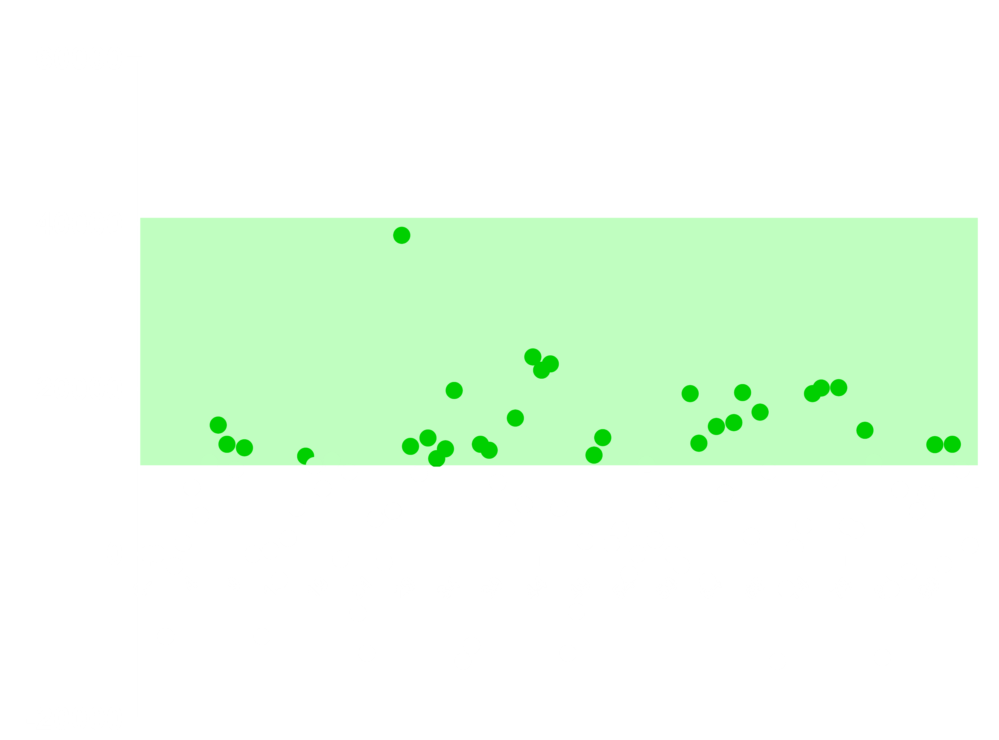
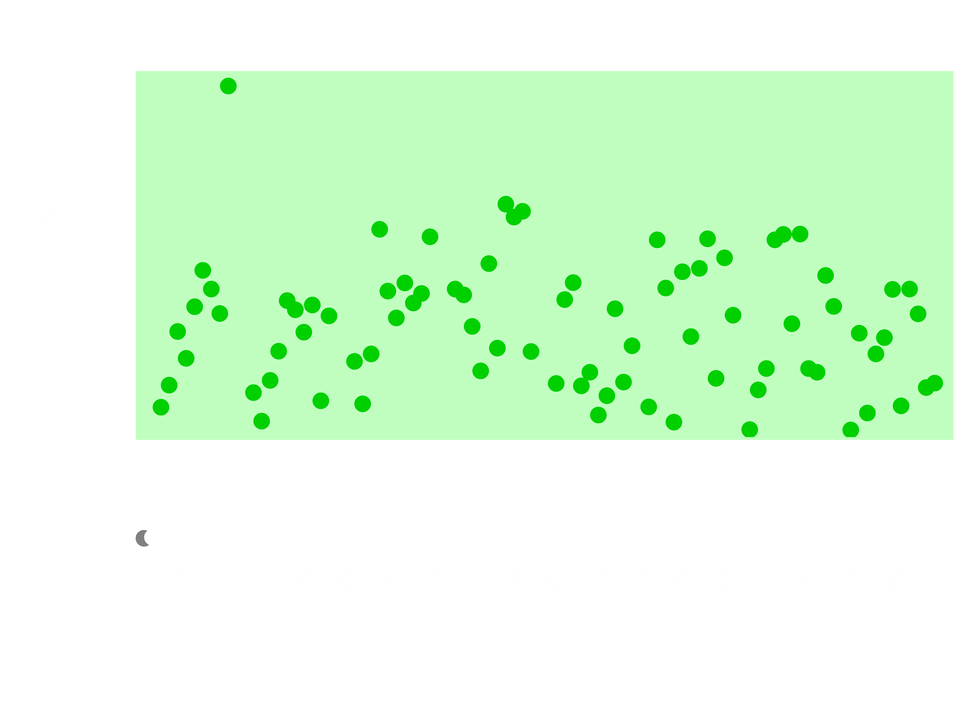
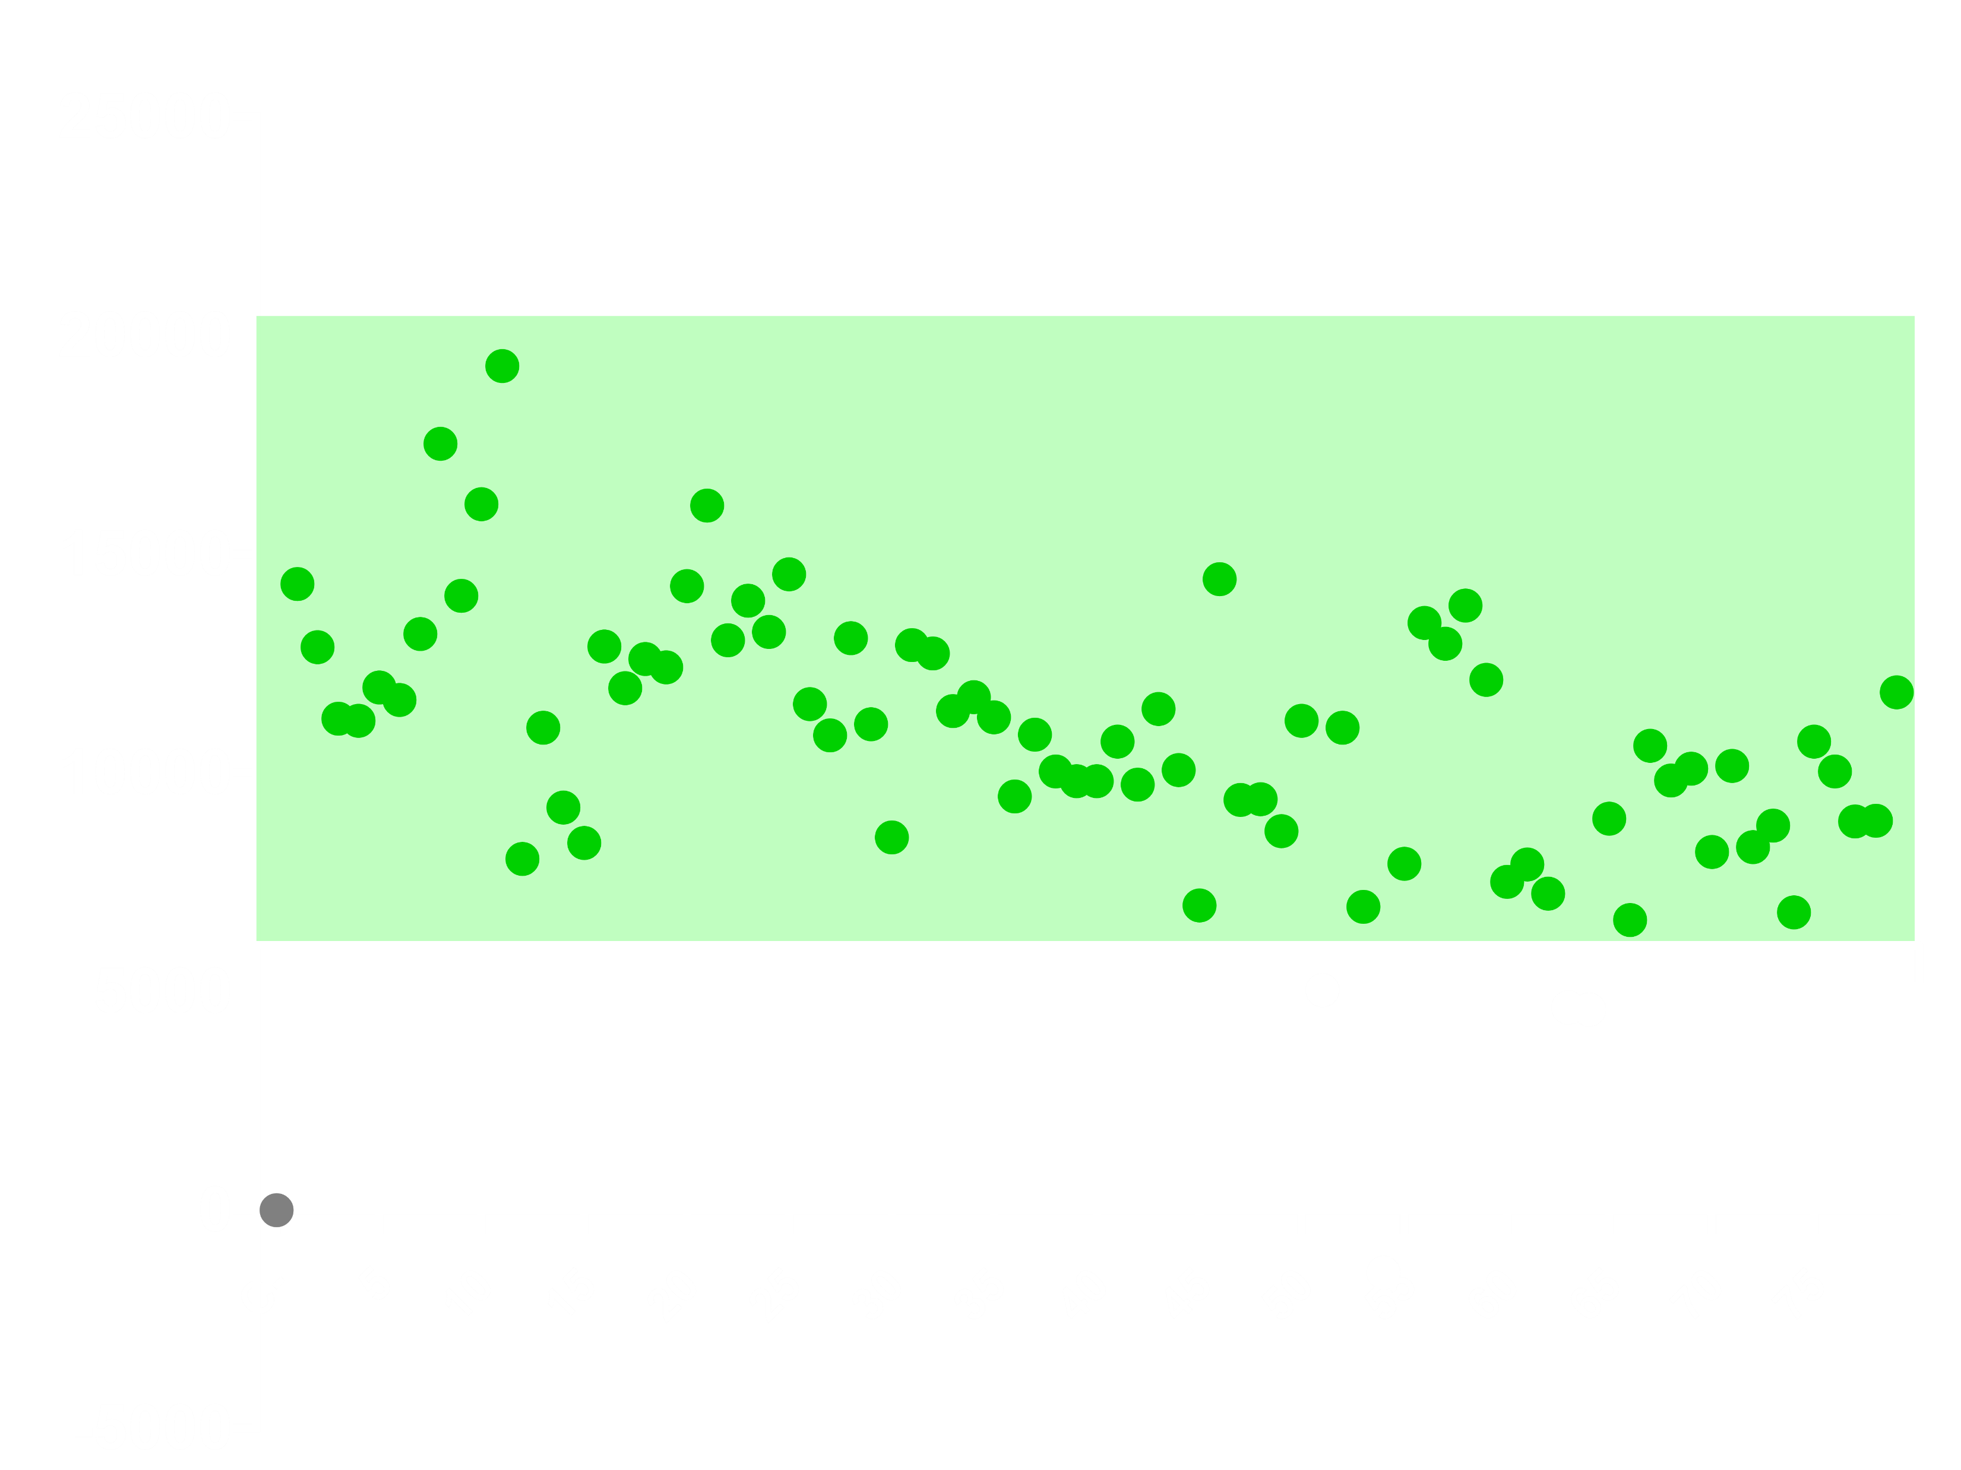

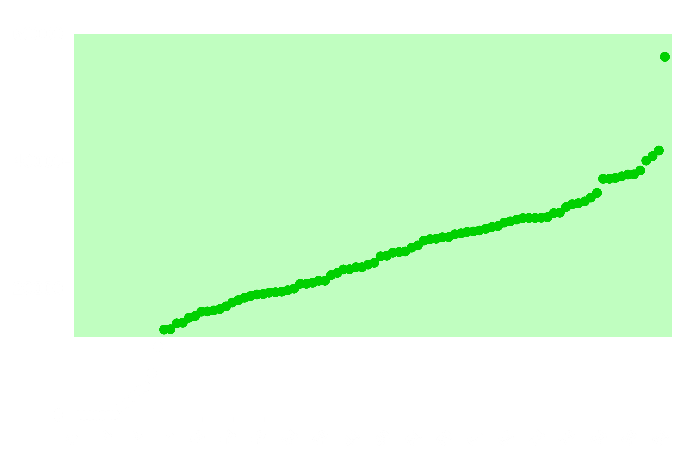
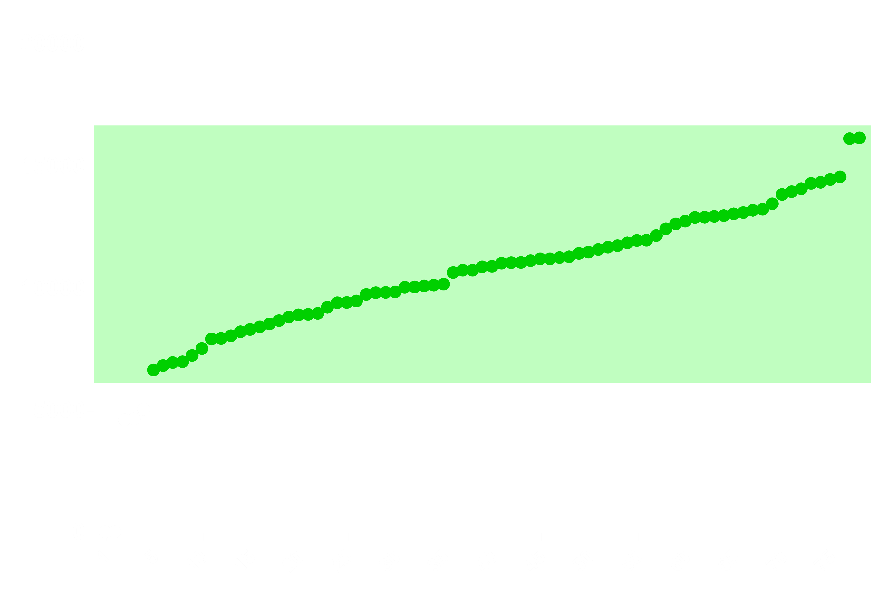
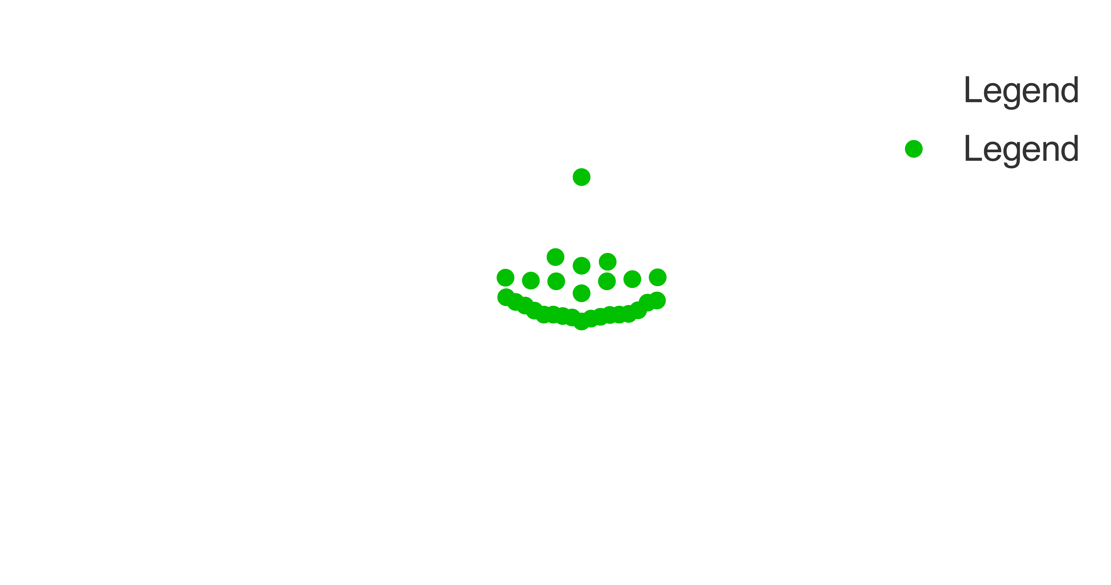

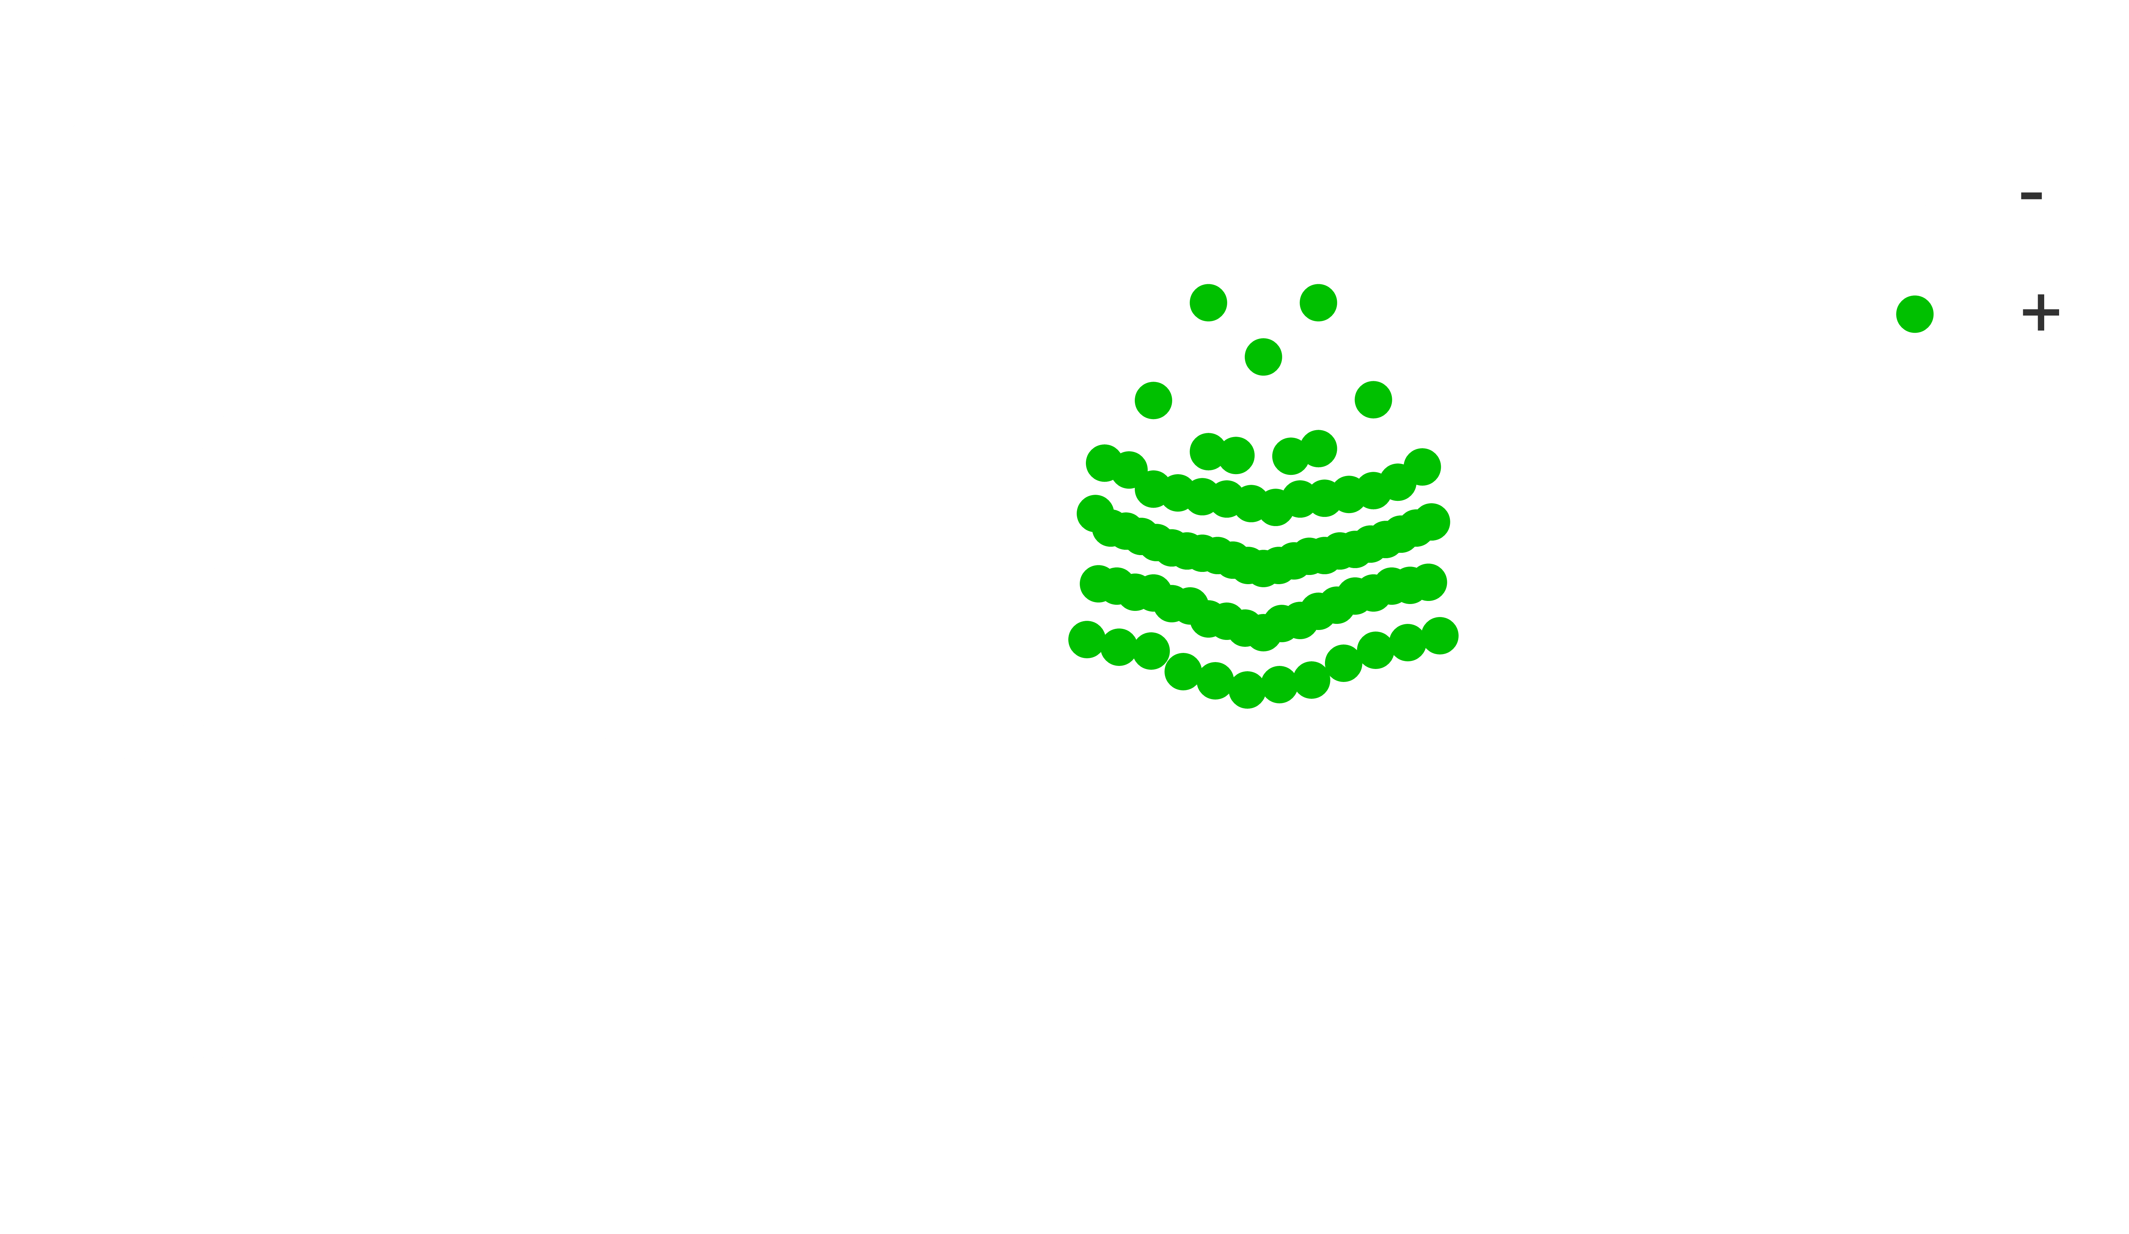
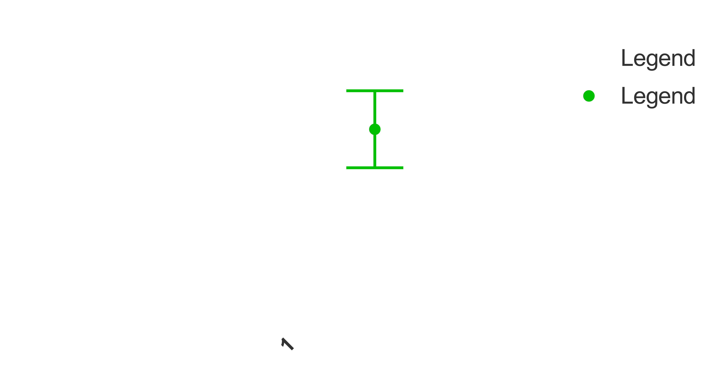
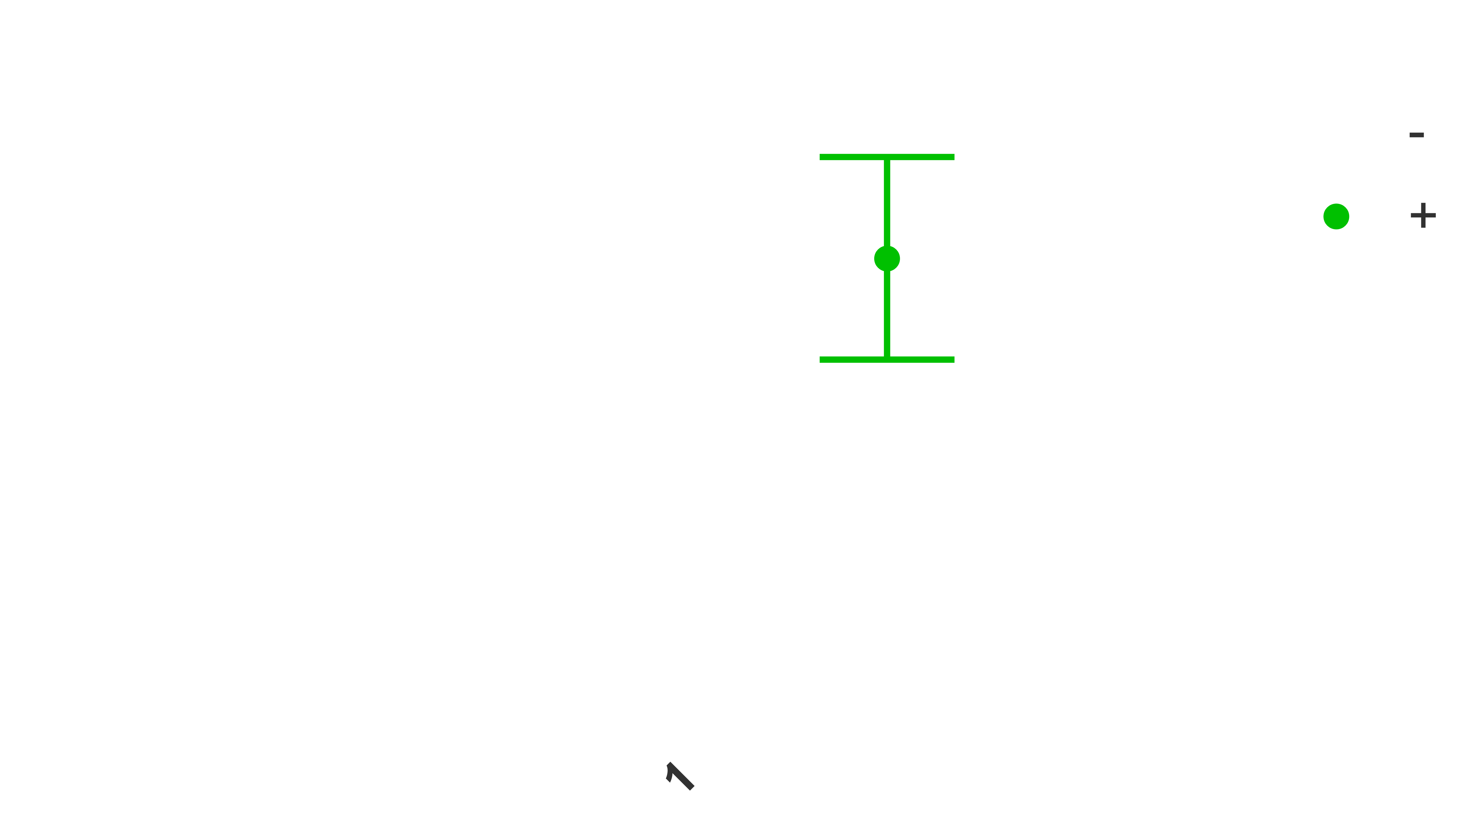
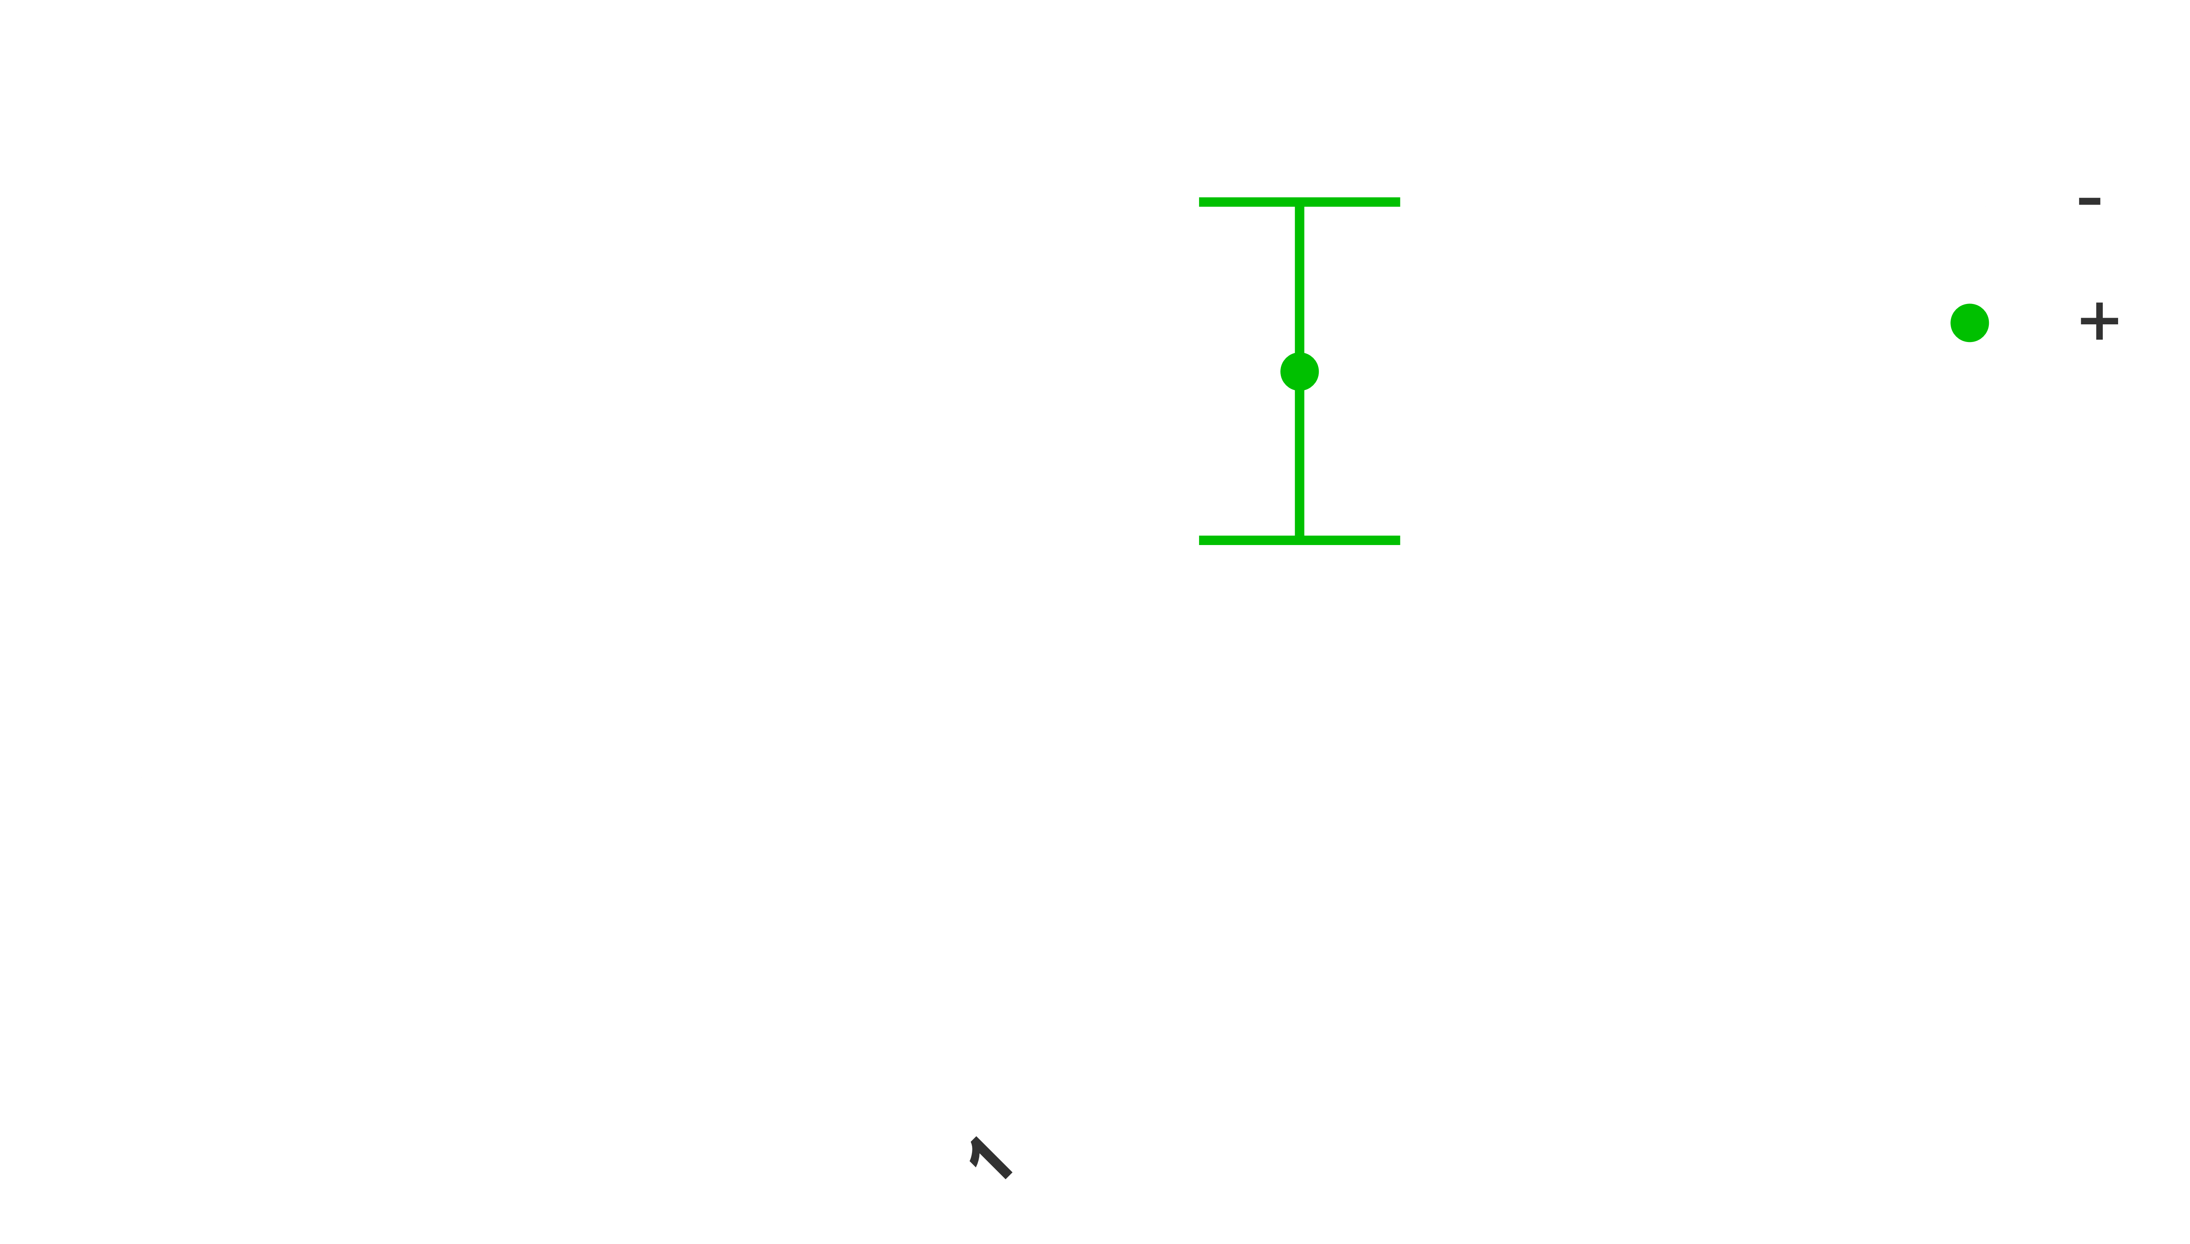
Cells beyond the threshold
Analyzing the fluorescence emission deviation on the experiment population
A) non pre-inducted Cas9
B) pre-inducted Cas9 AND RecA
C) pre-inducted RecA
GFP+
GFP+
GFP+
CFUs
CFUs
CFUs
threshold
threshold
threshold
-10.000 to +10.000 negative range
-5.000 to +5.000 negative range
Fluorescence emission augmentation
Negative and positive GFP CFUs in ascending order
Negative and positive population patterns
Average and standard deviation of populations

Slide 3
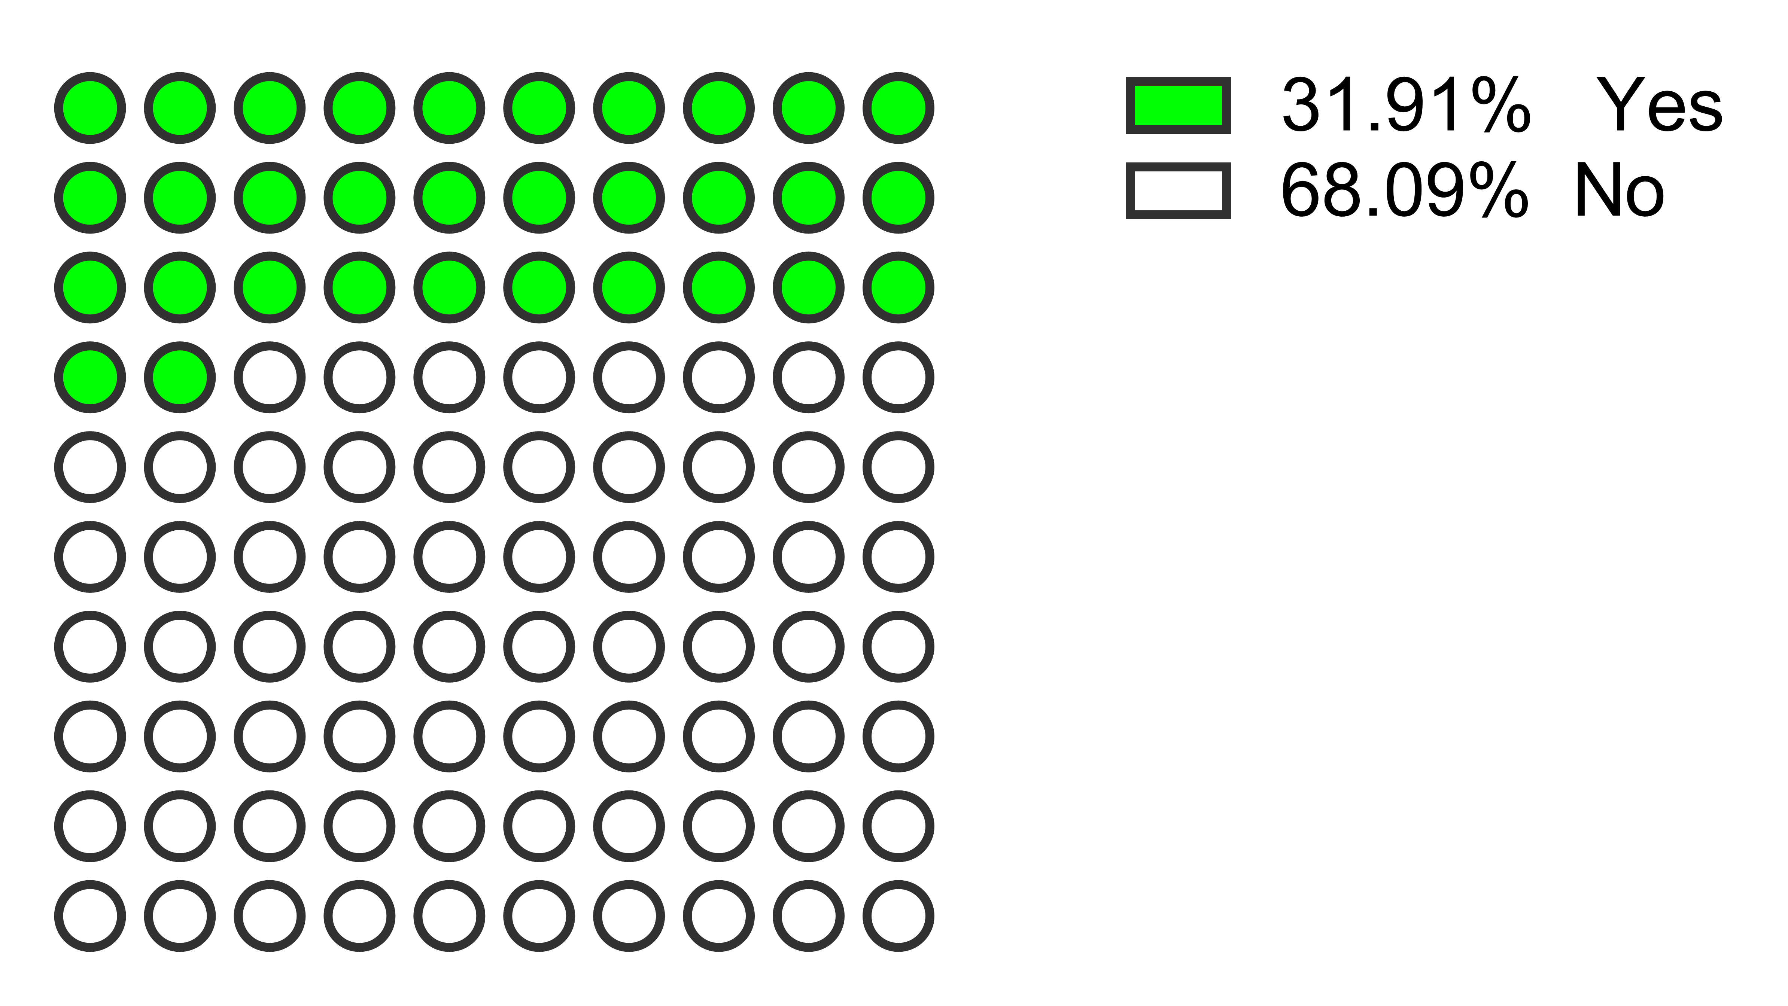
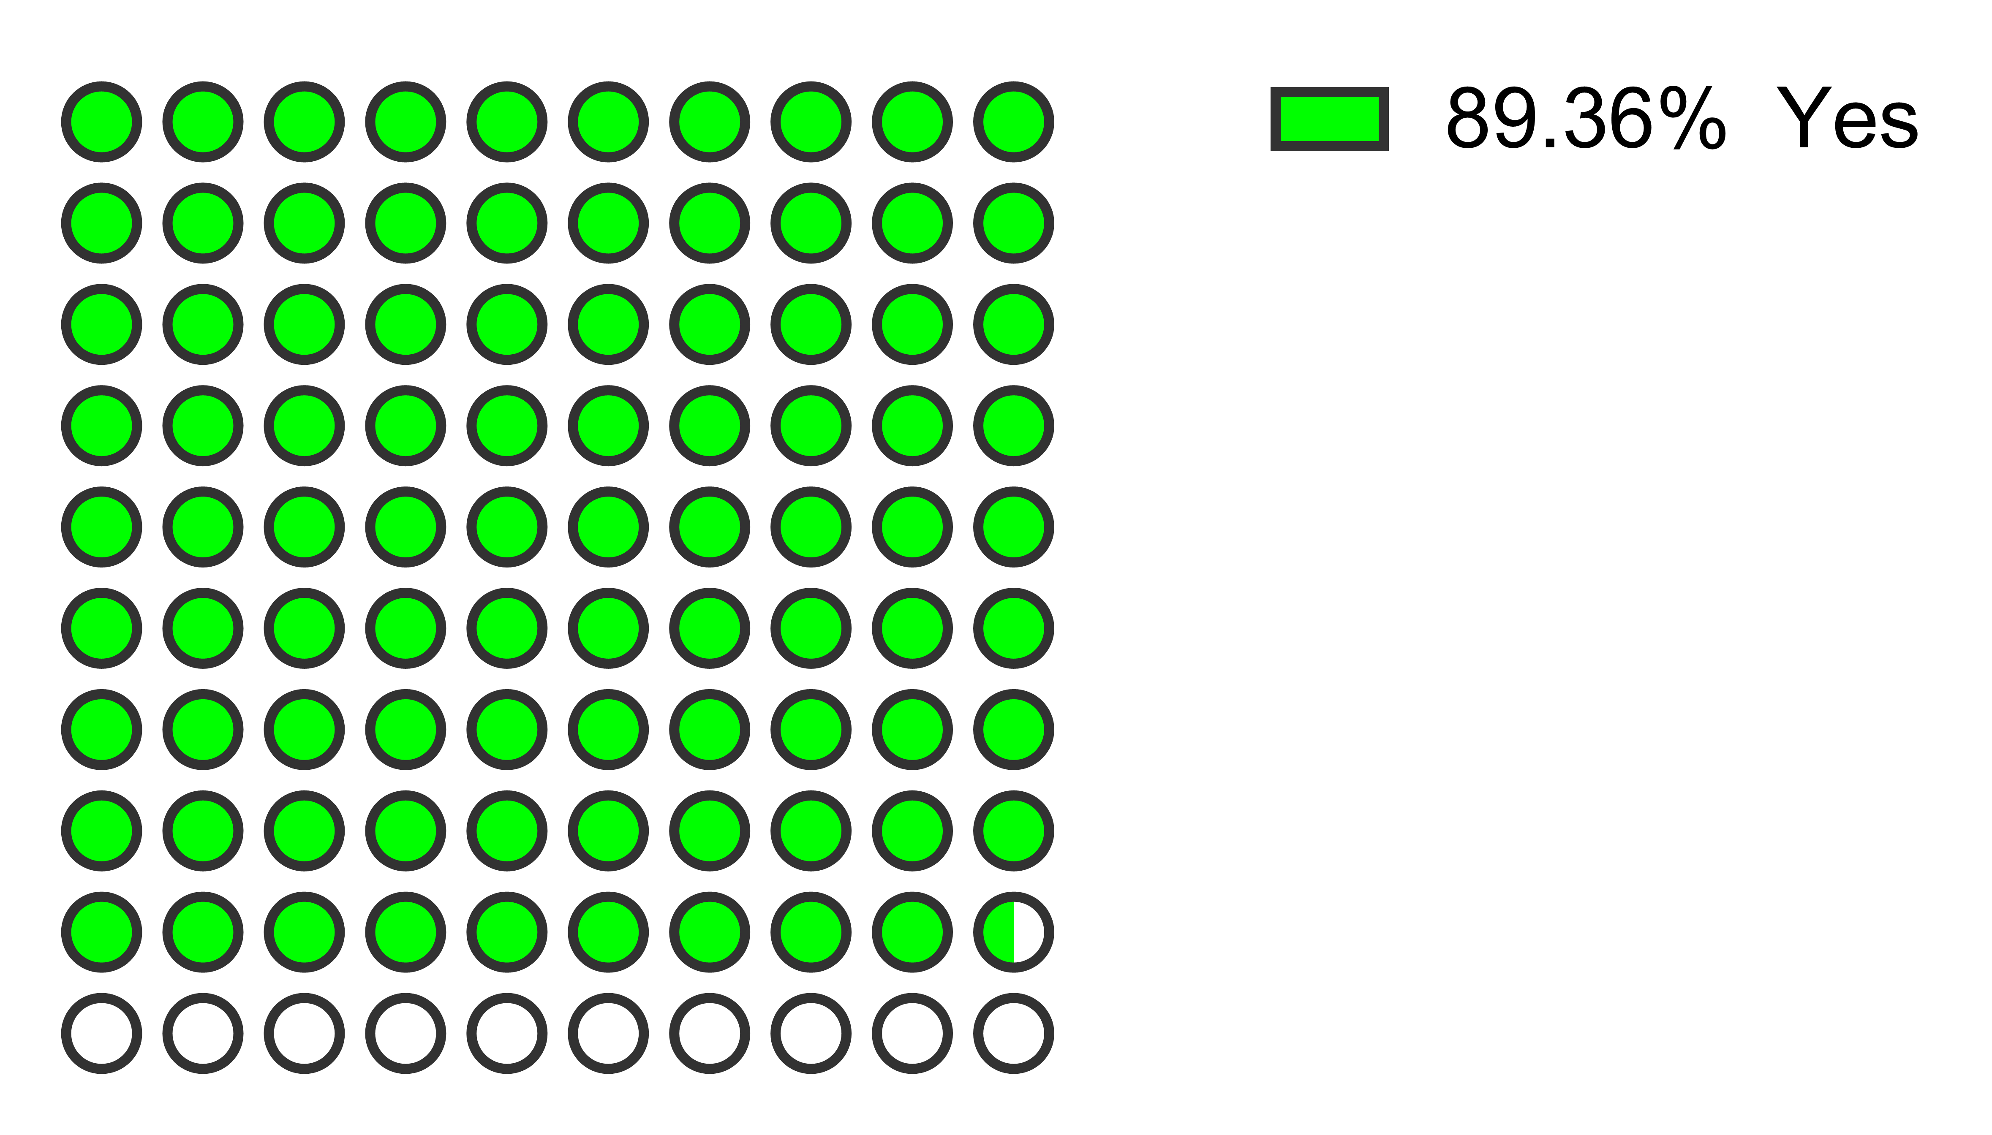
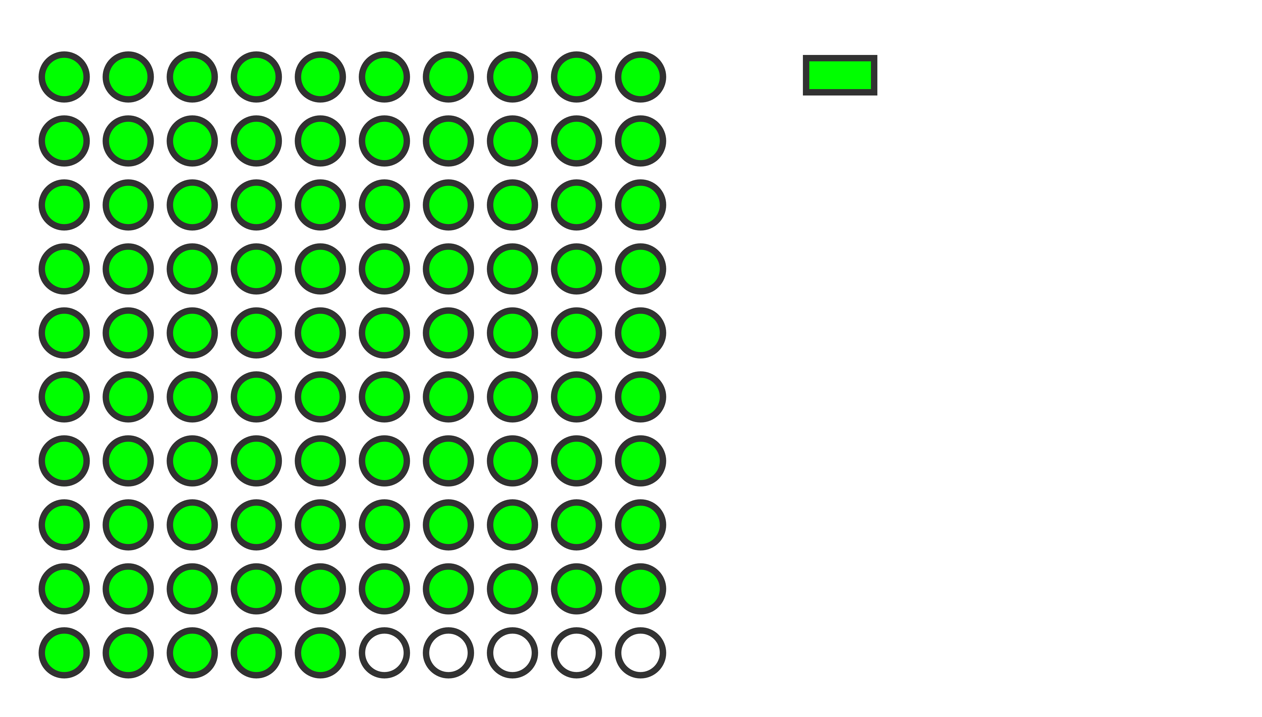



CROSS-CHECKING POPULATIONS
A) non pre-inducted Cas9
B) pre-inducted Cas9 AND RecA
C) pre-inducted RecA
from 94 CFUs
from 94 CFUs
from 80 CFUs
34
84
76
GFP
inserted
GFP
inserted
GFP
inserted
into genome
into genome
into genome
In percentage...
30%
90%
95%
of engineering efficiency
verified by GFP+ beyond the threshold

Slide 5
understanding the impact of editing machinery on cell growth through genetic regulation
+ glucose 1%
- glucose 1%

Slide 6
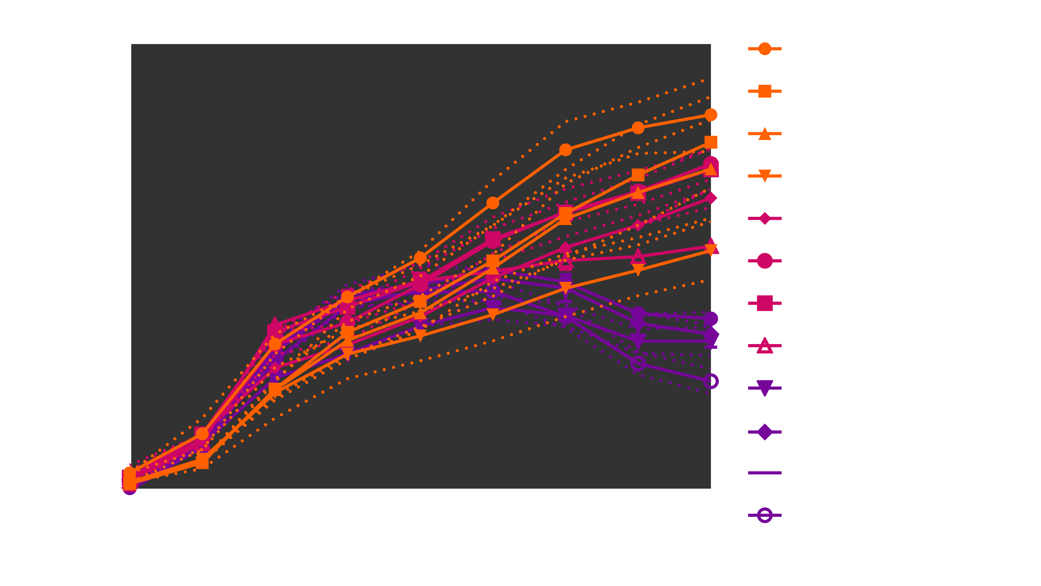
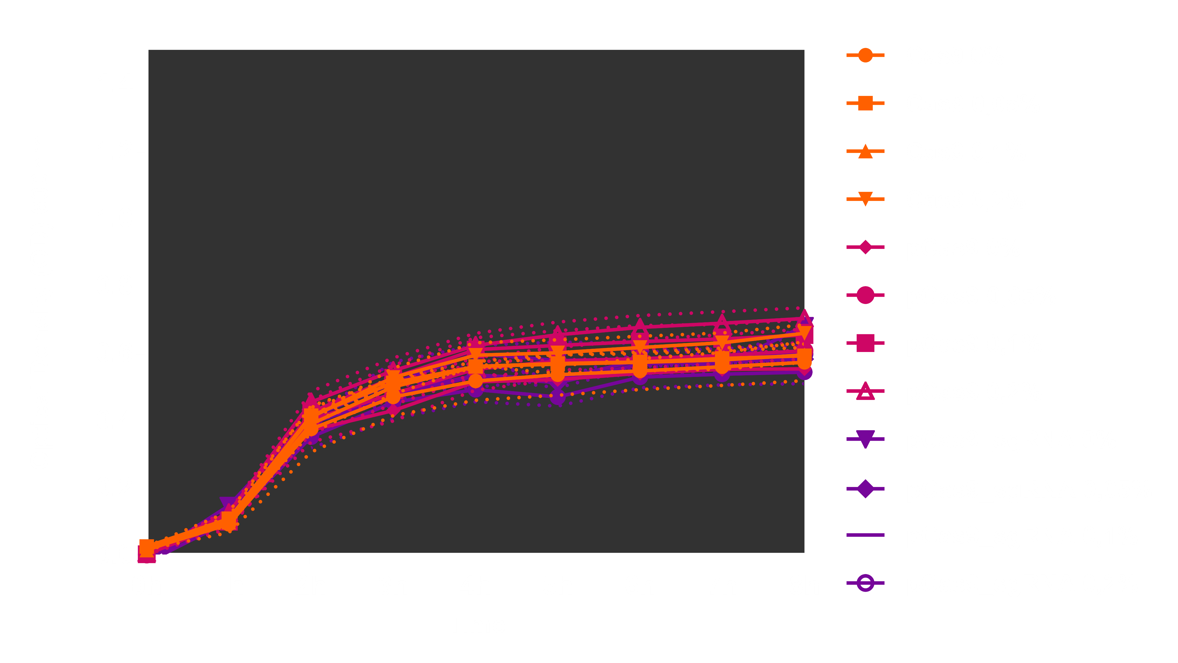
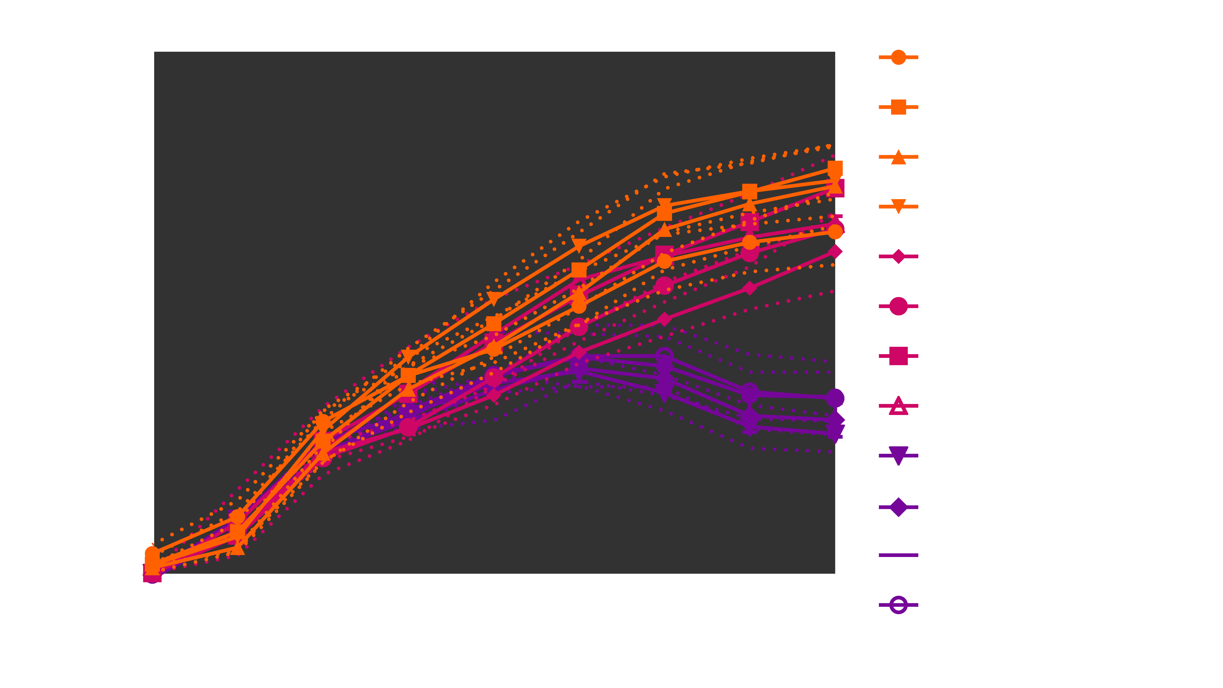
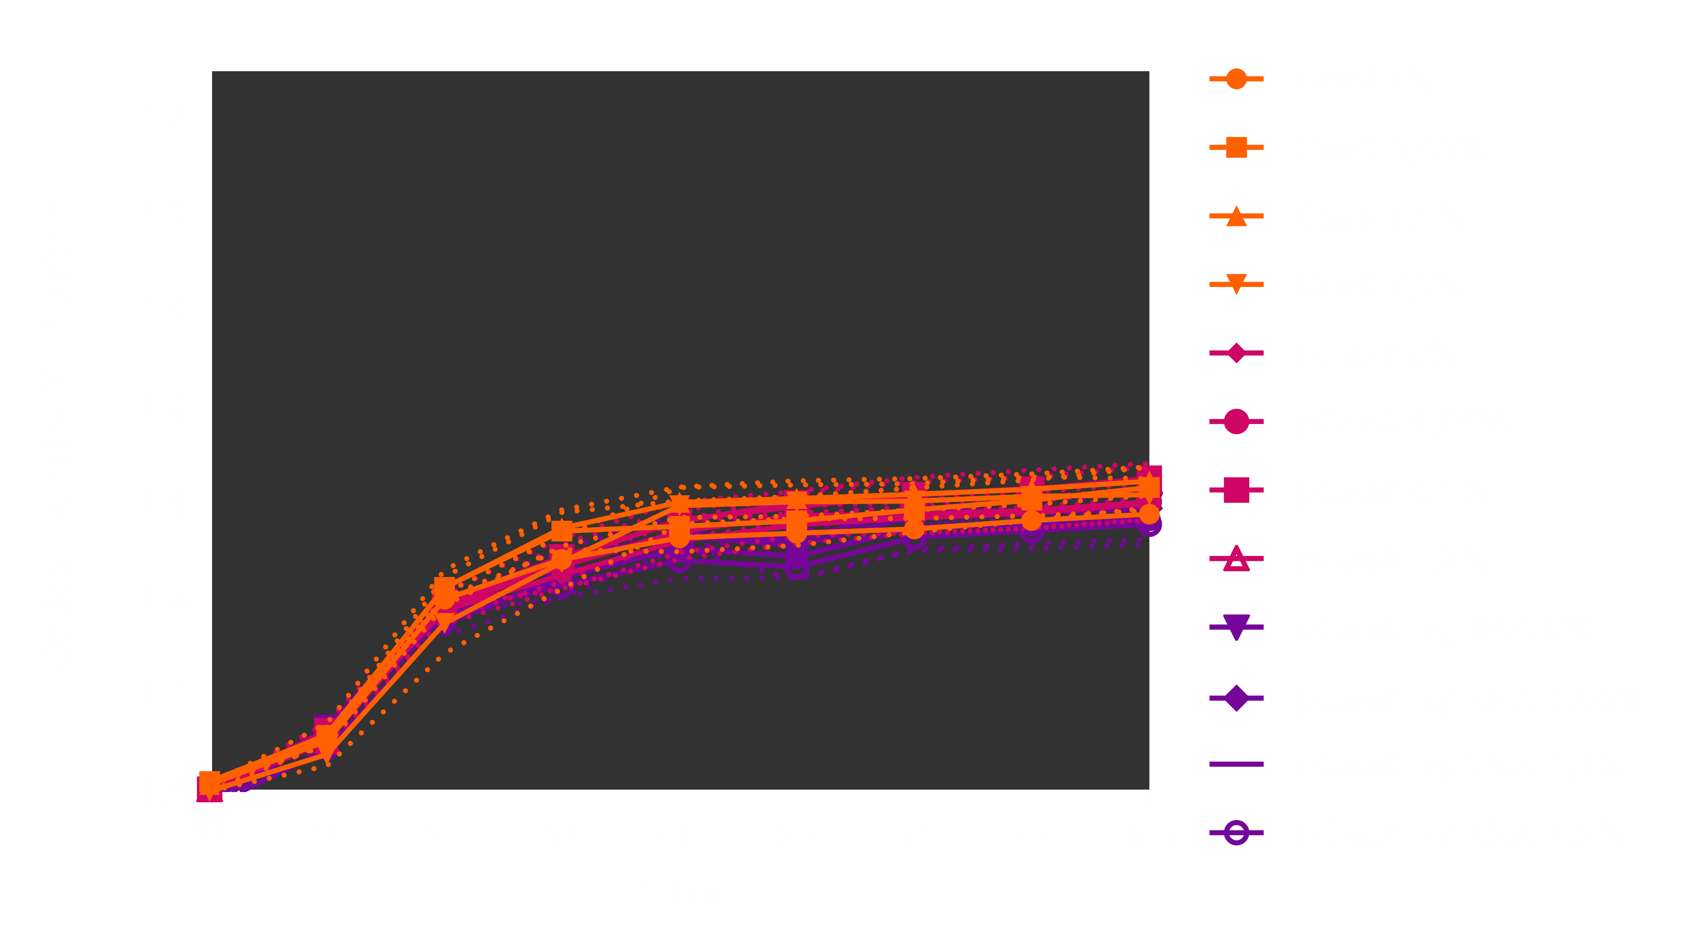
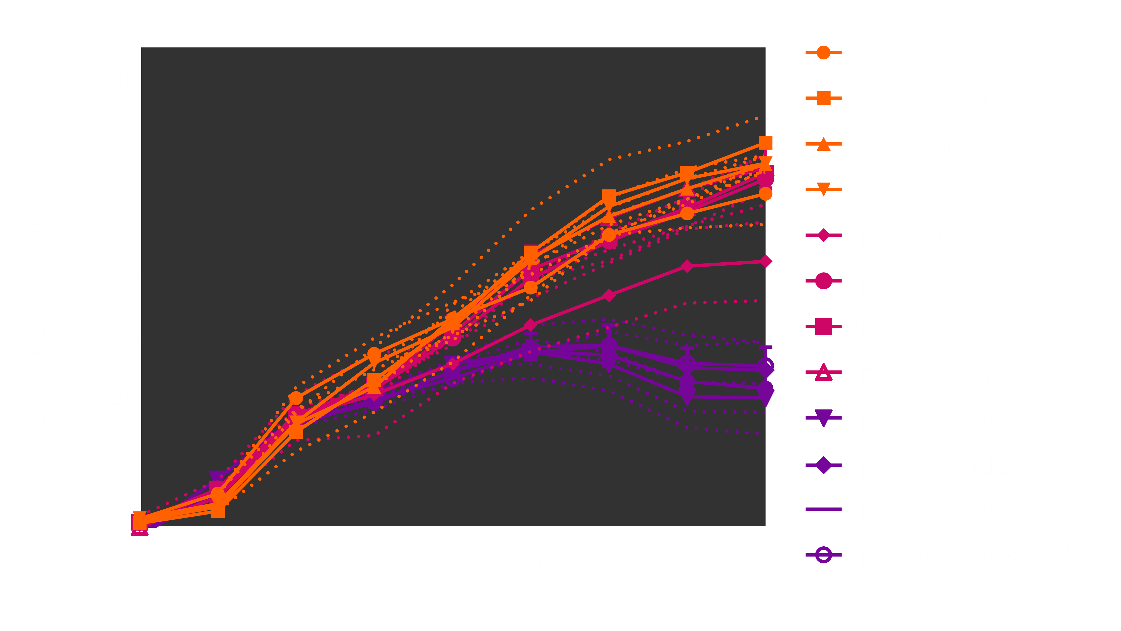
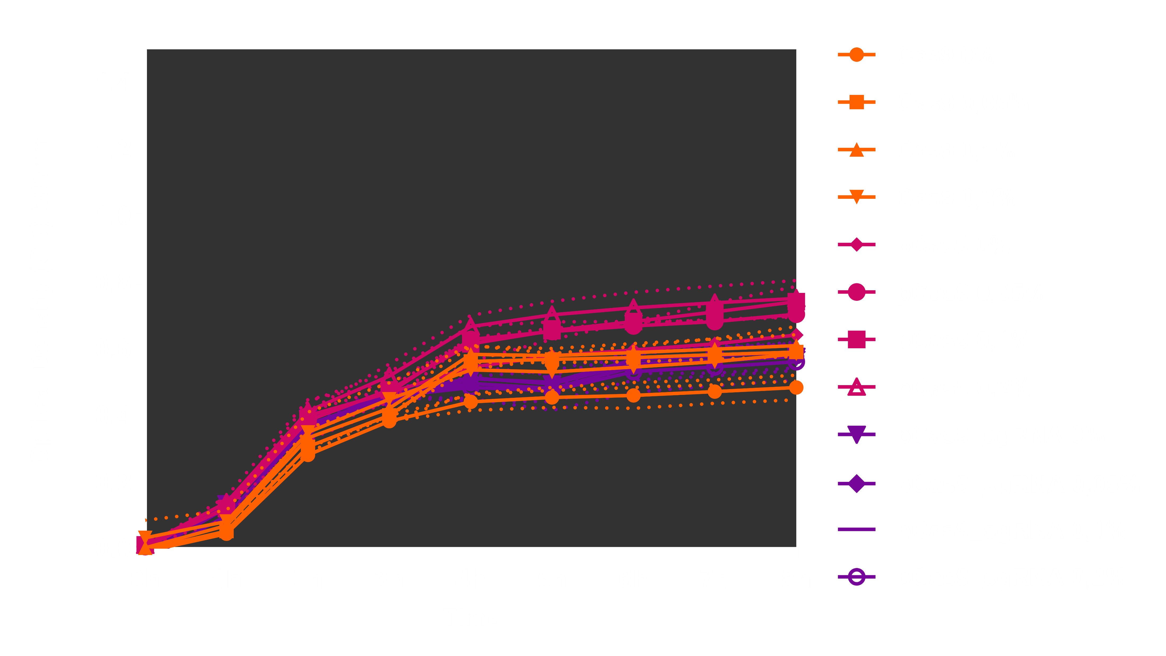
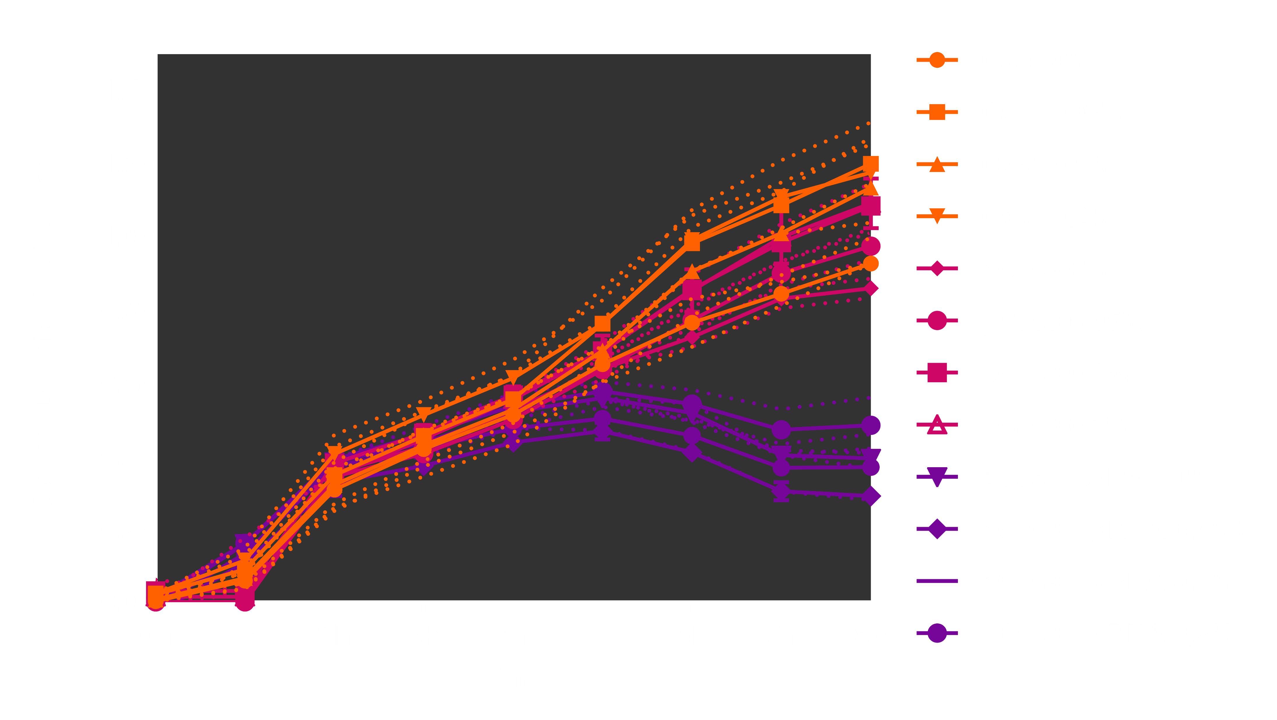


Slide 7
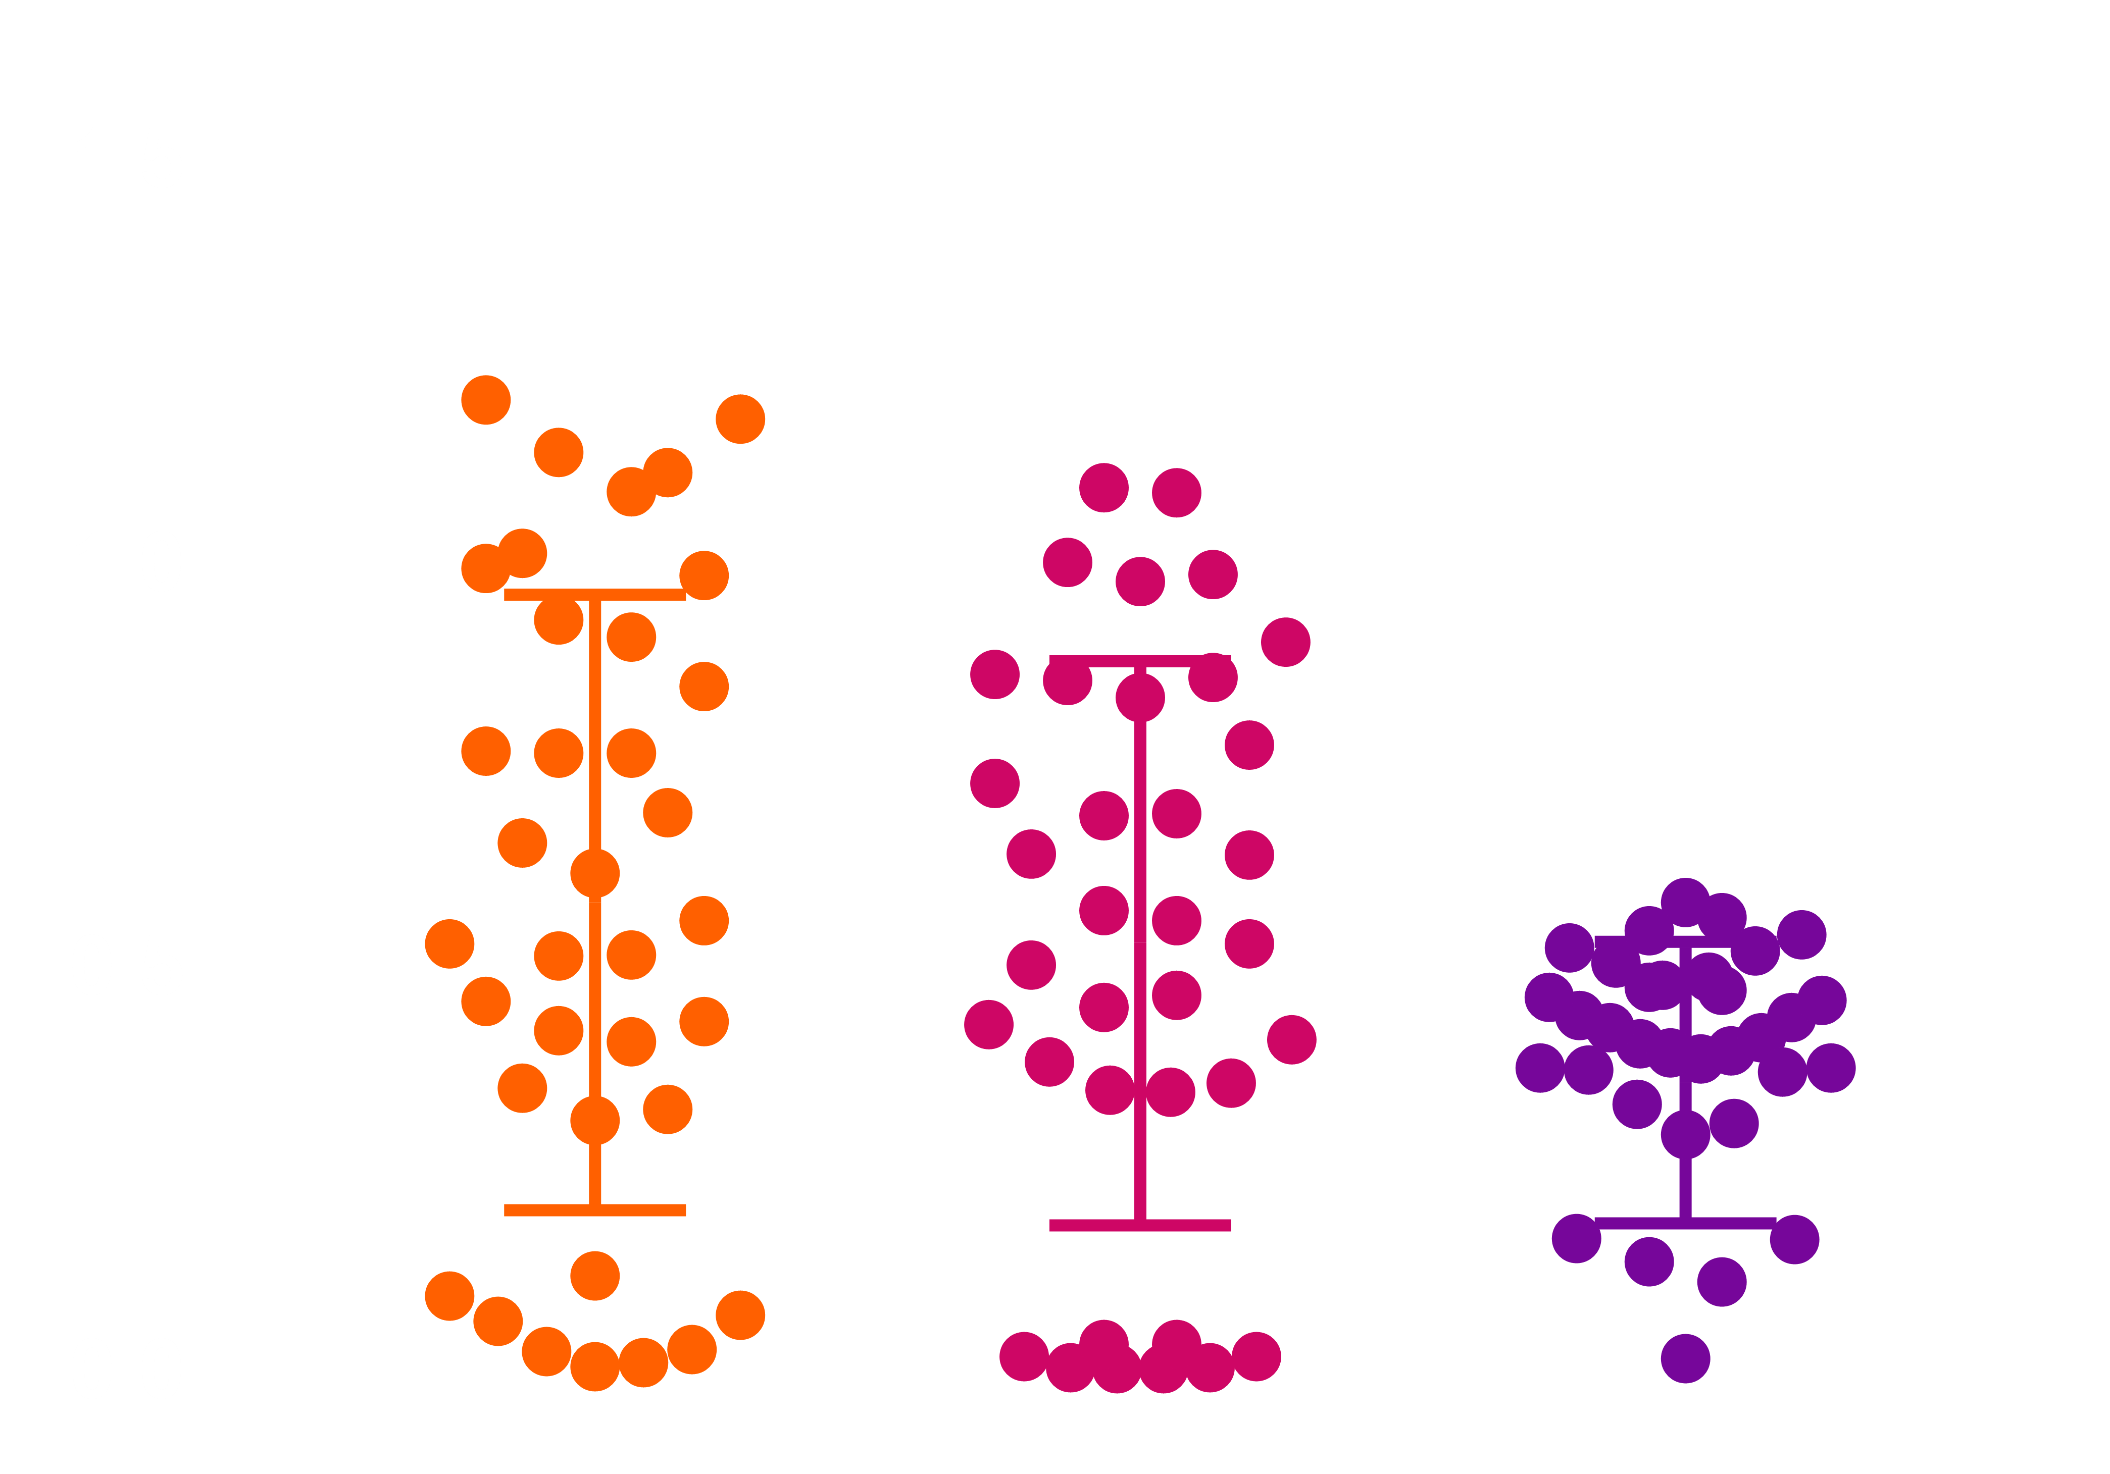

- glucose%
+ glucose%

